Slide 1
Koj puas ntseeg has tas,
Muaj ntuj ceebtsheej
Hab
Ntuj tawg?

Slide 2
Yog koj ntseeg has tas,
Muaj ntuj ceebtsheej hab
Muaj ntuj tawg kub?
Qhov twg yuav zoo rua koj?

Slide 3
Ca kuv nug koj ob lu lug le nuav?
Yog Yexus lug nub nua koj puas ntseeg has tas koj tau moog nrug Yexus nyob?
vim le caag koj txhaj xaav has tas koj tau?
Vim le caag koj xaav has tas koj tsi tau?

Slide 4
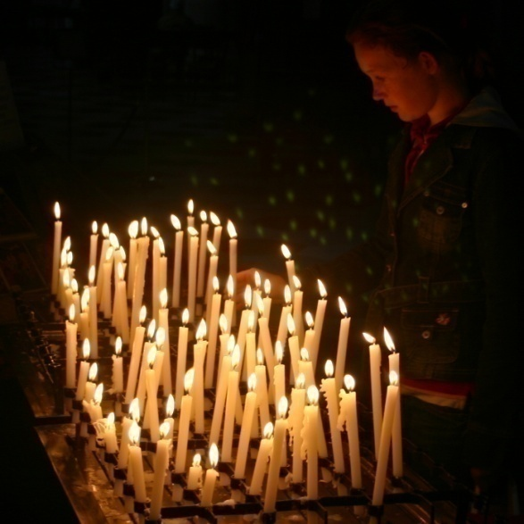
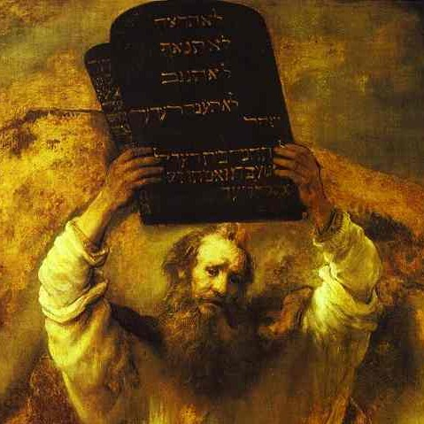
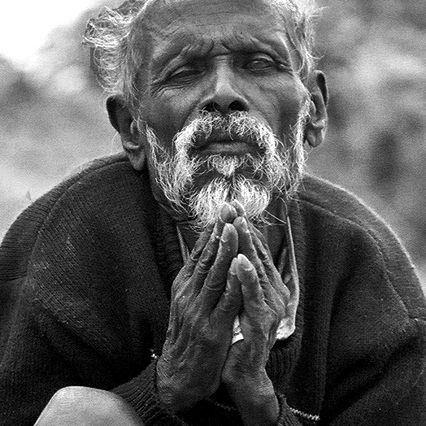
Yuav ua caag txhaj tau moog sau ntuj ceebthseej. Muaj 4 paab tuabneeg xaav le nuav:
Religion
Coj 10 Nqai Kevcai Nruj
Coj Ncaaj Nceeg
Ua tej nuav puas yuav paab kuas koj tau moog ntuj ceebtsheej?
Ua Neej Dlabhuv

Slide 5
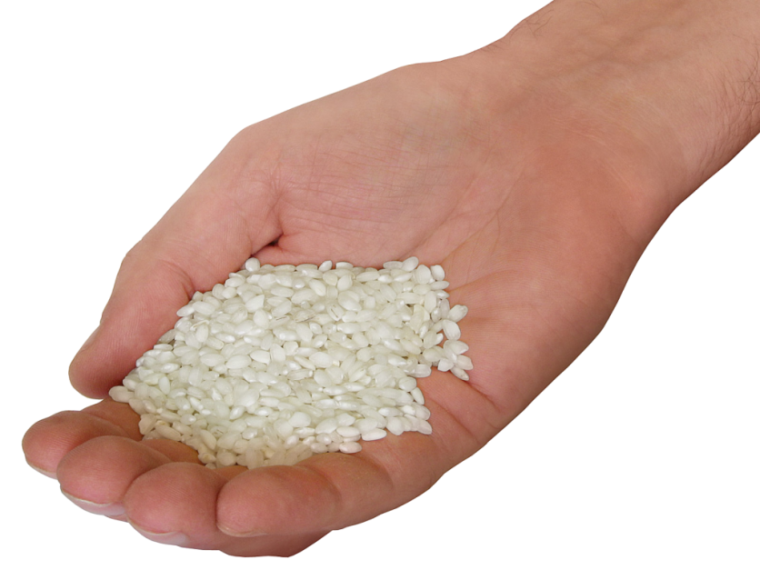
Tuabneeg xaav has tas kev moog sau ntuj zoo le tsaab teev kiv kev ua zoo
Yog ua zoo, hlub cov txomnyem, tes yuav kov yeej txuj kev phem, tes yuav tau moog sau ceebtsheej lawm puas yog?

Slide 6
Muaj tej tug tuabneeg xaav tas, muaj kev txhum miv hab kev txhum luj
Tabsis rua Vaajtswv tes txawm kev txhum miv-miv los yeej yog KEV TXHUM
I know you (God) get no pleasure from wickedness and cannot tolerate the slightest sin.
Psalm 5:4

Slide 7
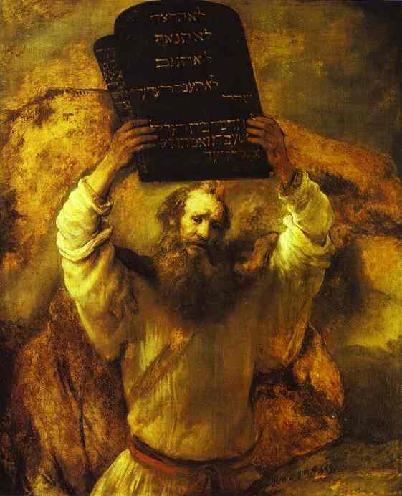
Txawm koj ua txhum ib nqai xwb los koj yeej txhum txhua nqai huv tuabsi
For whoever keeps the whole law and yet stumbles
at just one point is guilty of breaking all of it.
James 2:10

Slide 8
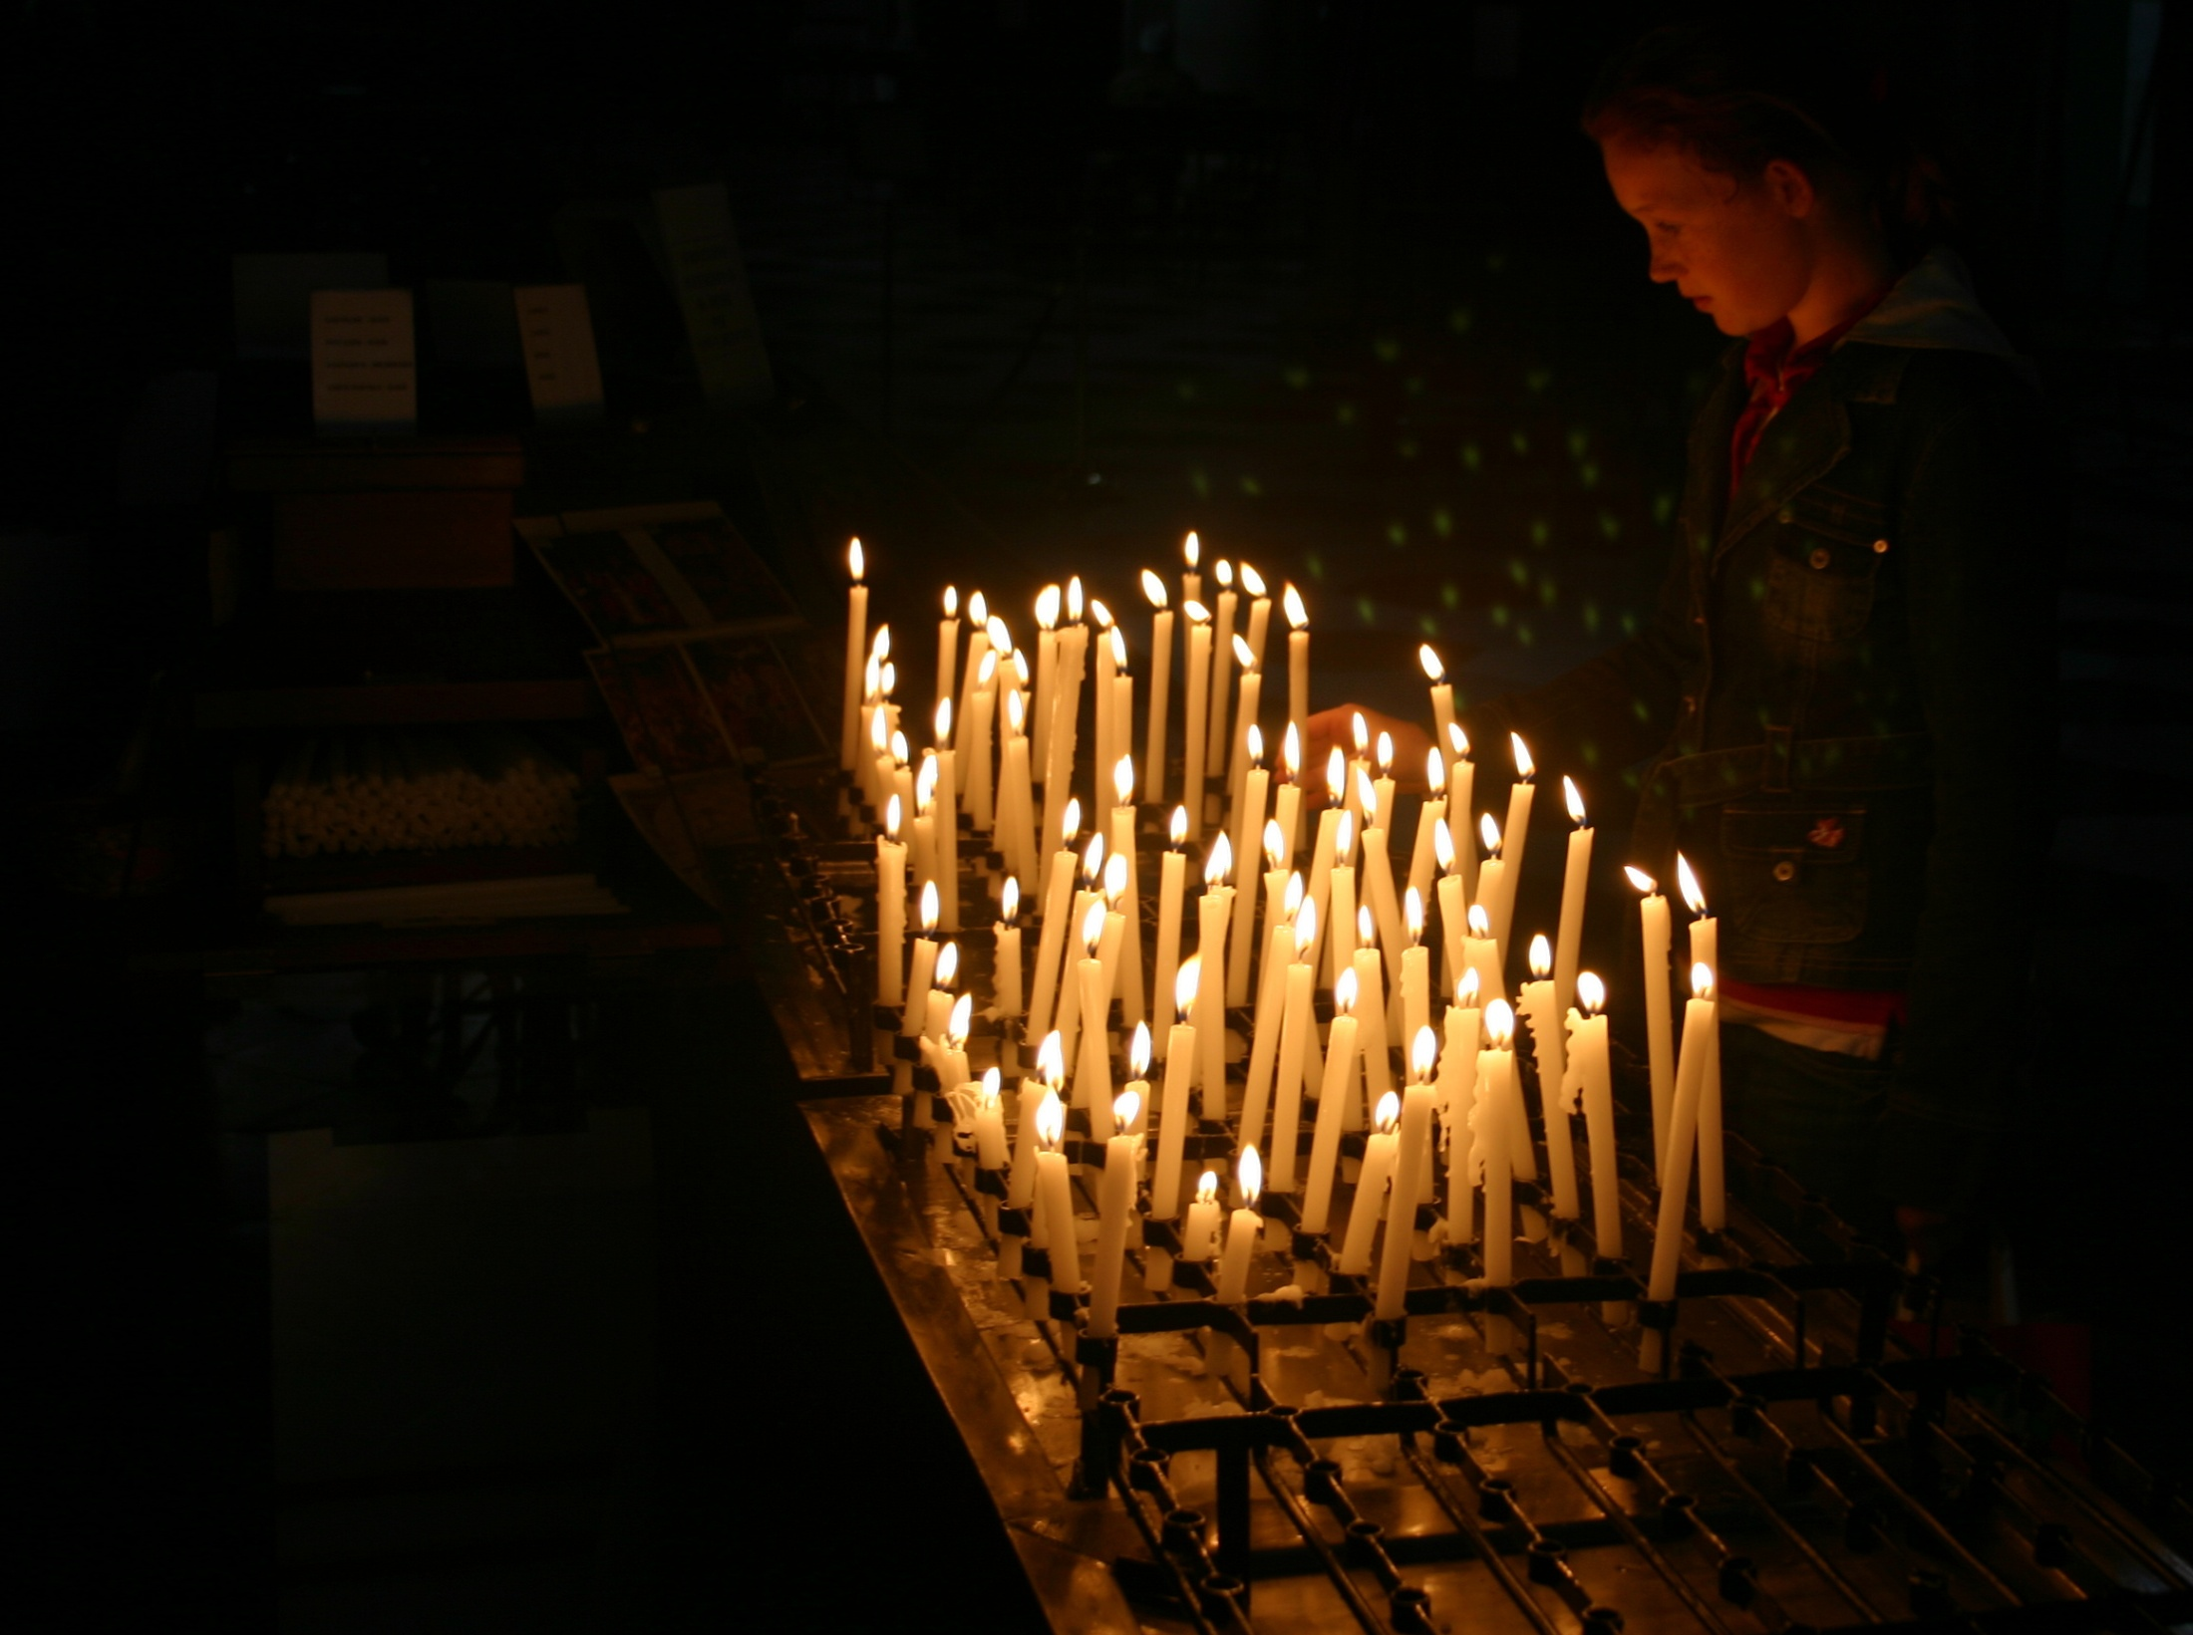
Taag nrho tej kev ntseeg nyob huv nplajteb nuav, qhov twg txhaj yog qhov yog?
Coob leej ntseeg has tas, kev moog thawj thab paab kuas yug dlim. Ib ntsiv koj yug ua ib tug qwj nib?

Slide 9
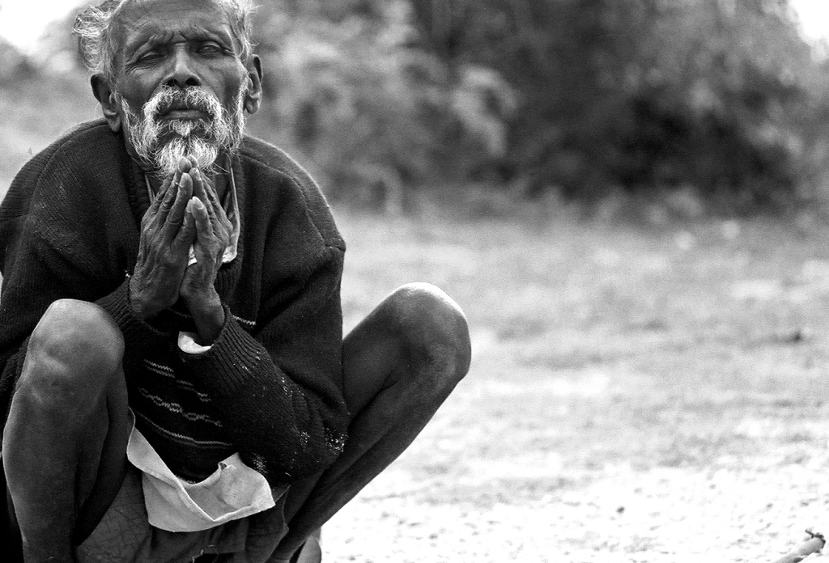
Txawm yuav coj kev ntseeg
Nruj hab ua neej dlawbhuv
los yeej zoo tsi txaus Vaajtswv sab nyam le?

Slide 10
Vaajtswv txujlug yeej qha tseeb has tas, txawm peb yuav:
Ua lub neej zoo (good wokrs)
Coj kev cai nruj (Religion)
Coj 10 nqai kevcai nruj
Ua lub neej ncaaj nceeg
los peb yeej tsi tau txais txujsa ntev dlhawv moog ib txhis!
Peb yuav ua le caag peb txhaj le tau txais txujsa ntev dlhawv moog ib txhis maj?
Muaj kev….

Slide 11
Church—pawg ntseeg
Pawg ntseeg yog cov tuabneeg kws leeg has tas Yexus yog Vaajtswv tug tub hab lug tuag theej puab lub txhoj. Puab txaus sab lug ntseeg Yexus hab txais Yexus ua puab tug Tswv hab tug cawmseej. Puab lug sis txoos uake ua ib pawg ntseeg.

Slide 12
2
Tuabneeg qhov teebmeem
Peb muaj teebmeem vim peb ua txhum.
Vaajtswv yog tug dlawbhuv Nwg yuav raug txim rua tug muaj txhum.

Slide 13
Vaajtswv tsim tuabneeg nrug Nwg nyob hab txaus sab rua Vaajtswv.
Vim tuabneeg txaus sab tsi noog Vaajtswv. Tuabneeg txhaj poob rua txuj kev txhum hab muab peb cais ntawm Vaajtswv lawm.

Slide 14
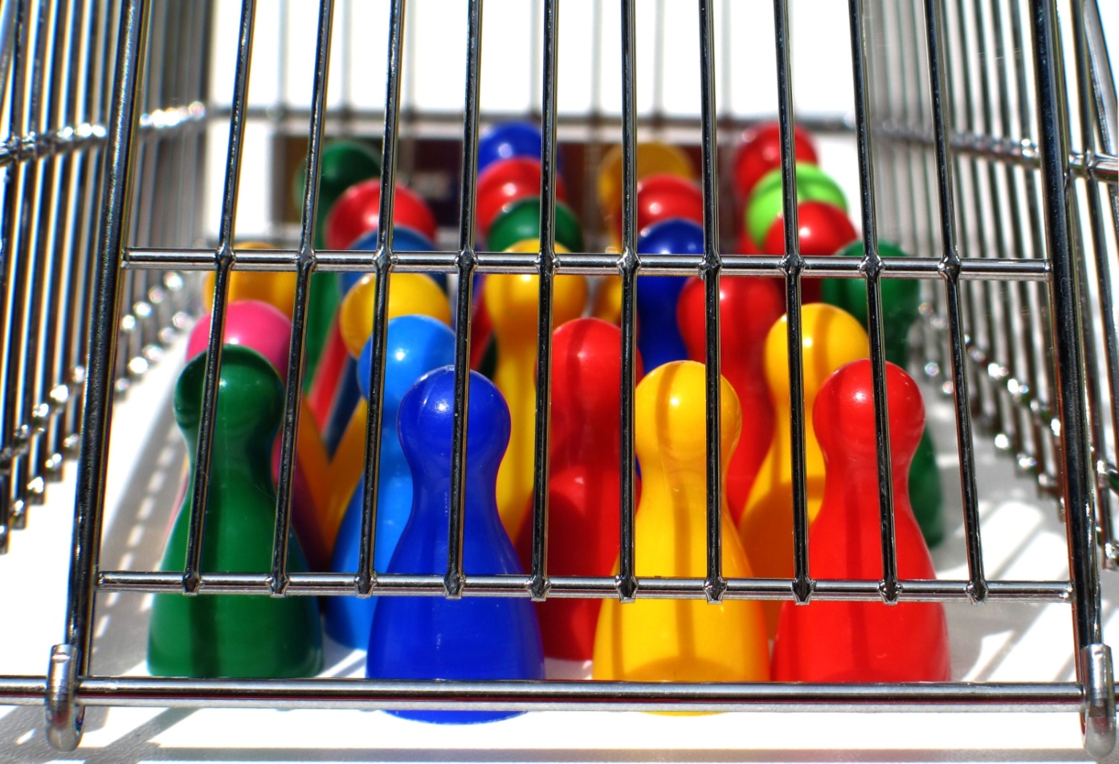
Vaajtswv txujlug qha tas peb txhua tug ua txhum
Rua qhov txhua tug puav leej ua txhum hab tu ncua Vaajtswv tug tshwjchim lawm Loos 3:23
Peb txujkev ntshaw hab xaav ua txhum ua rua peb ua tsi tau hum Vaajtswv sab nyam, vim Vaajtswv ntxub txujkev txhum.

Slide 15
Nujnqe ntawm kev txhum yog dlaabtsi?
Nujnqe ntawm txujkev yog kev tuag.
Loos 6:23
Peb yuav tsiv tsi dlim txuj kev rau txim nuav.

Slide 16
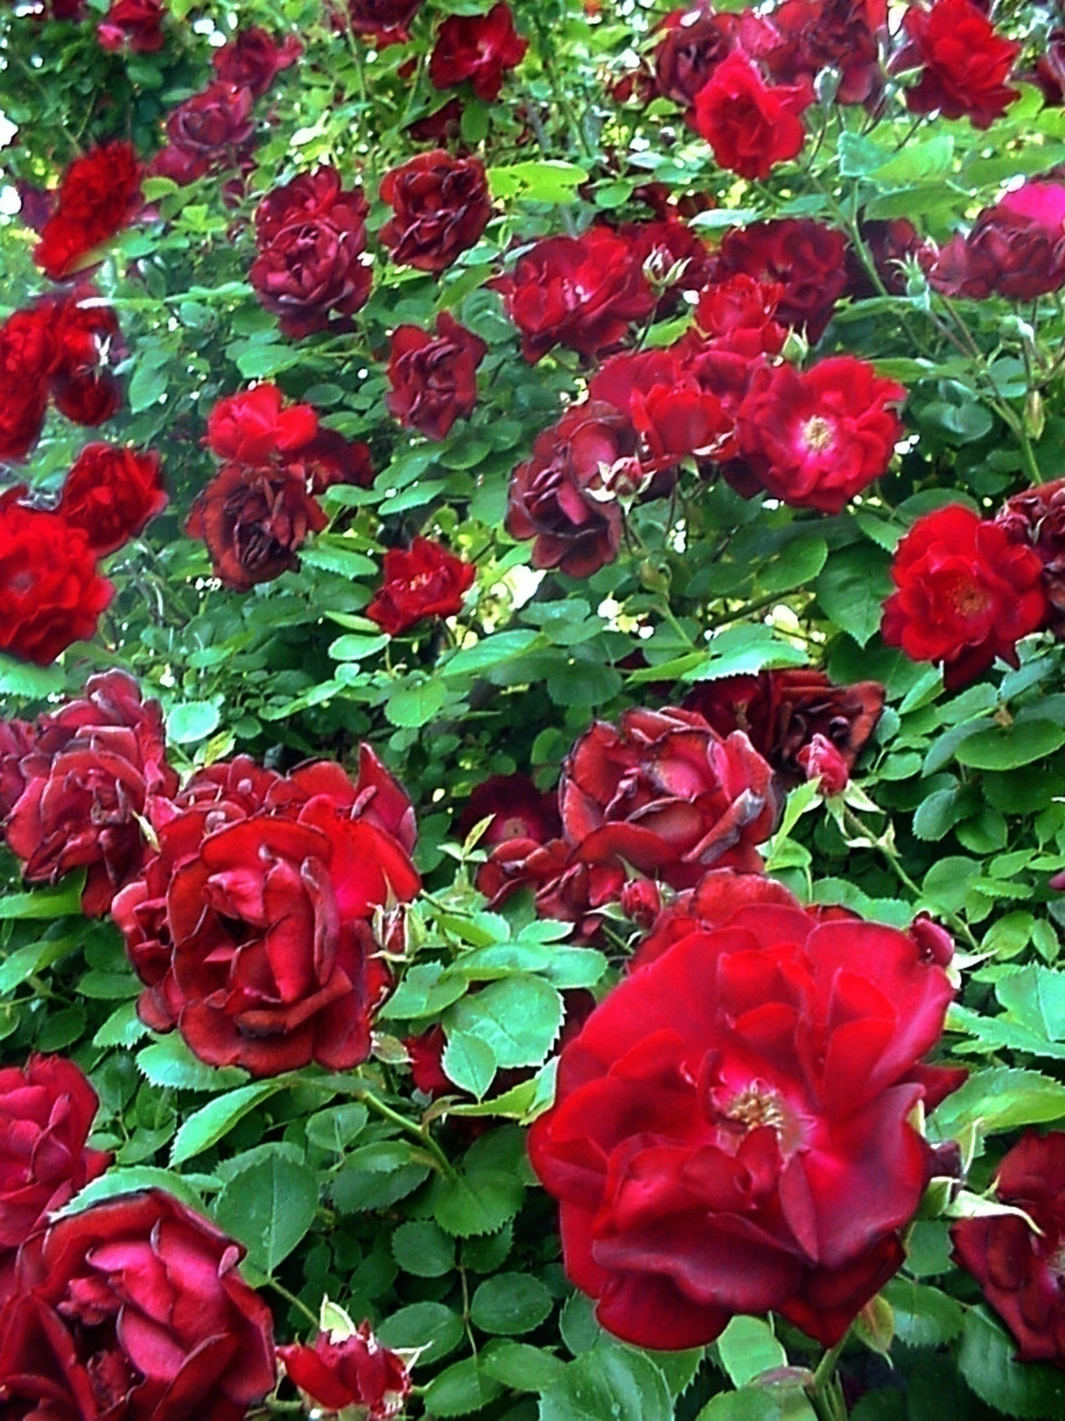
Yog peb txav ib lub paaj hab muab rau dlej ca?
Nwg yuav caj los nwg yuav tuag?
Yog peb tseg nwg ca ntev zog tes yuav zoo le nuav?
Yog txav ib lub paaj tawm ntawm tsob paaj lawm tes tuag xwb.
Peb zoo le lub paaj nuav vim kev txhum muab peb txav tawm ntawm Vaajtswv lawm.

Slide 17
Puas yuav muaj kev casab rua tuabneeg?
Peb yuav ua le caag txhaj dlim tau?
Txawm peb tsim nyog tuag los Vaajtswv tso peb dlim!

Slide 18
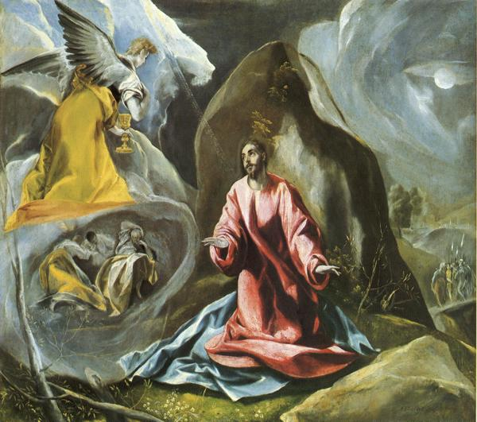
Yexus yog tug yuav cawm tau tuabneeg nplajteb xwb!
3
Yexus teb has tas, “Kuv yog txujkev, yog qhov tseeb, hab yog txujsa; tsi muaj leejtwg moog cuag tau Leejtxiv tsua yog moog ntawm kuv moog xwb txhaj tau.” Yauhaas 14:6
Nwg has tas kuv yog txujkev—yog tuab txujkev xwb!

Slide 19
Yuav ua caag peb txhaj paub tseeb has tas peb taug txujkev yog lawm? Yexus yog txujkev!
“... he was buried, ... he was raised on the third day according to the Scriptures…. After that, he appeared to more than 500 of the brothers at the same time….
1 Corinthians 15:4-6
Thaus Yexus tuag. Nwg sawv huv qhov tuag rov qaab lug. Nuav qha tau has tas nwg yog Vaajtswv tug Tub tag.
He was shown to be the Son of God when he was raised from the dead by the power of the Holy Spirit. He is Jesus Christ our Lord.
Romans 6:23

Slide 21
4
Tuabneeg teg dlejnum
Paub cov ntsablug tseeb nuav xwb tsi txaus. Peb yuav tau teb Vaajtswv hab txais yuav Vaajtswv txuj kev cawmdlim kws Yexus muab rua peb.
Yuav ua le caag txhaj tau?
Click here to continue.

Slide 22
God’s Word says that salvation is a gift of God and not a result of human works. Not by religion or by sincerity or by obeying laws – it is available only by God’s grace.
It is something we do not deserve and cannot earn.
It is by grace you have been saved, through faith – and this not from yourselves, it is the gift of God – not by works, so that no one can boast.
Ephesians 2:8-9
not by works

Slide 24
We must respond in faith.
Faith simply means believing God’s Word and that he will do exactly as he said he would.
This includes the need to acknowledge our sins before him, because true faith involves turning away from what displeases him.
It means surrendering our lives to God.

Slide 25
Yexus has tas,
Behold, I stand at the door and knock; if anyone hears My voice and opens the door, I will come in to him.
Revelation 3:20
I will come in to him.
Yog koj hab kuv caw Yexus lug nyob huv peb lub sab. Nwg yuav muab txujsa ntev dlhawv rua peb.

Slide 26
You can receive Christ right now by simply going to God in prayer. Just talk to him. You might not know the words to say, but he looks deep into your heart to see what you are trying to tell him.
You can pray something like this.
Lord Jesus, I am sorry for my sins. Thank you for dying for me on the cross. With your help, I will turn away from my sins. Today I am putting my trust in you as my Lord and Savior and I receive you into my heart. Thank you for forgiving my sins and coming into my life. I accept your free gift of eternal life. Thank you that one day I will be with you in heaven. From this day on, I will follow and obey you. Amen.
Click here to continue.

Slide 27
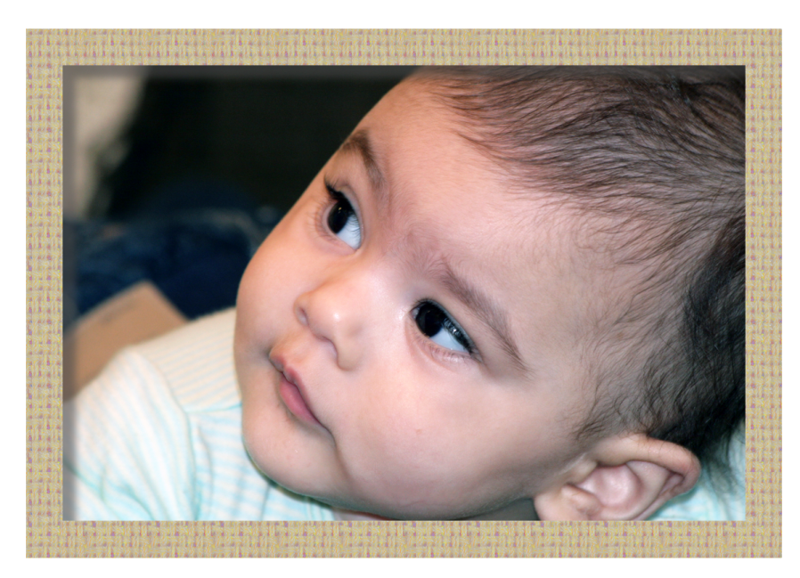
If you prayed that prayer, congratulations. What’s happened to you?
To all who received him, to those who believed in his name, he gave the right to become children of God.
John 1:12

Slide 28
This is what God has testified: he has given us eternal life, and this life is in his Son. Whoever has the Son has life; whoever does not have God’s Son does not have life. I have written this to you who believe in the name of the Son of God so that you may know you have eternal life.
1 John 5:11-13
he has given us eternal life,
Whoever has the Son has life;
Because you have accepted Jesus the Son of God, God’s word declares that you have eternal life.

Slide 29
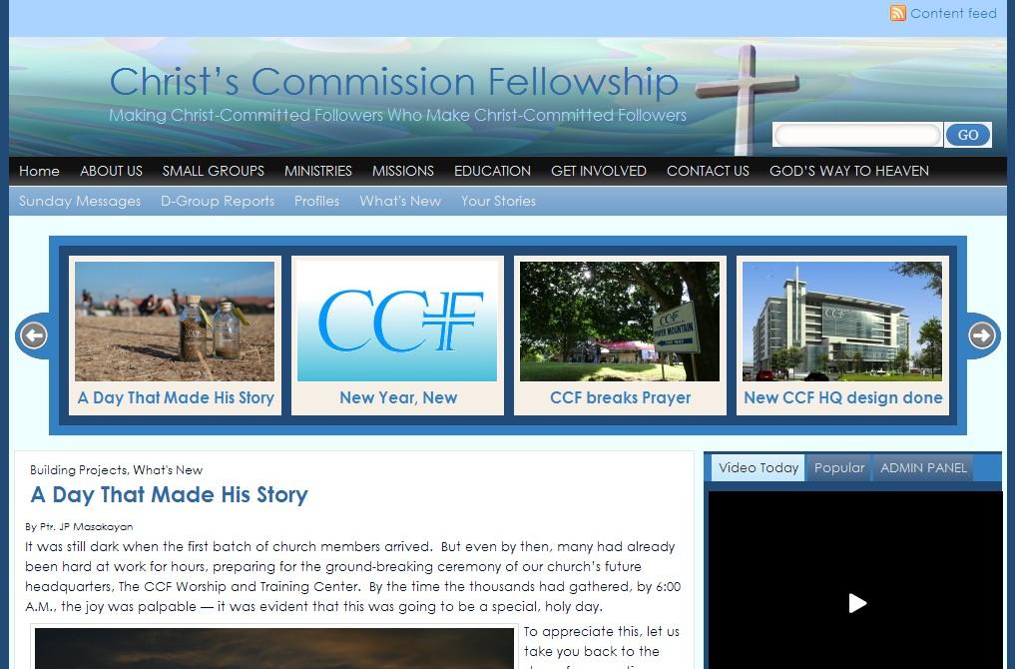
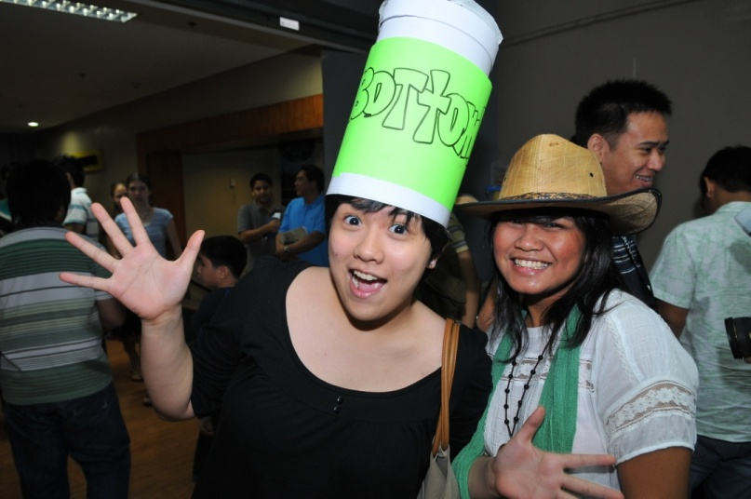
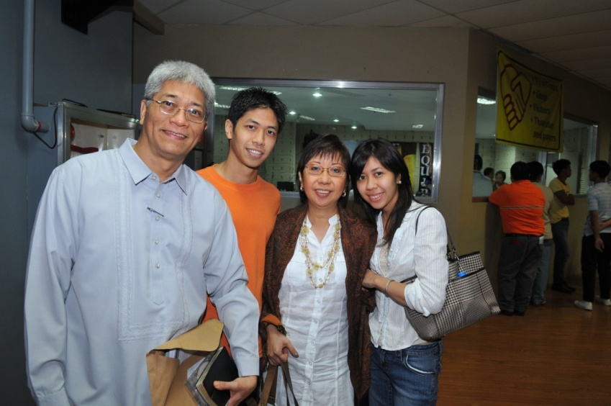
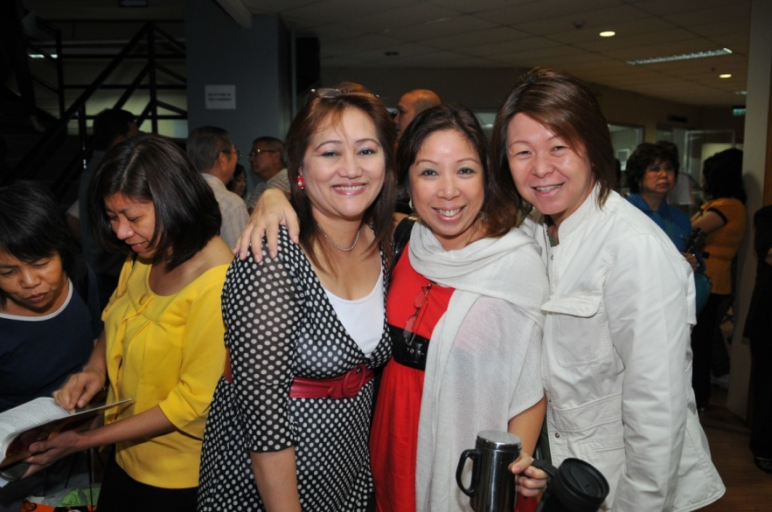
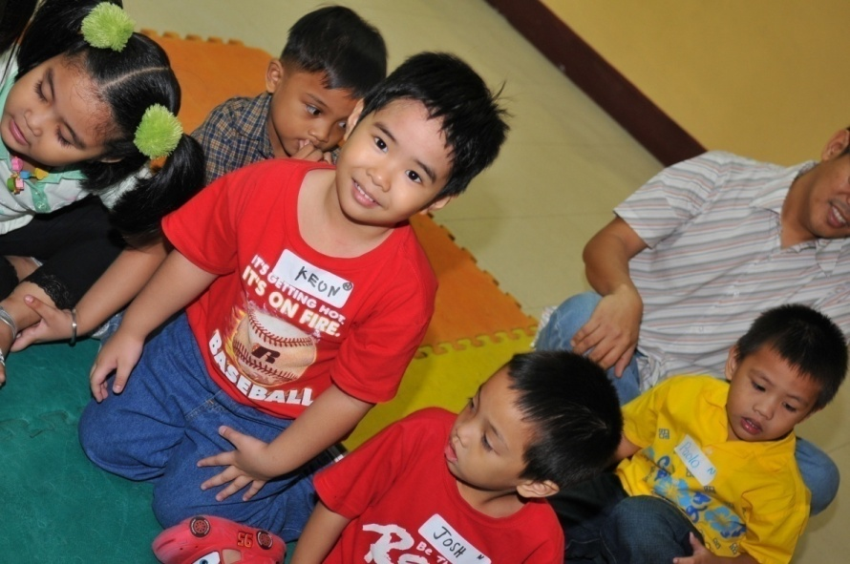
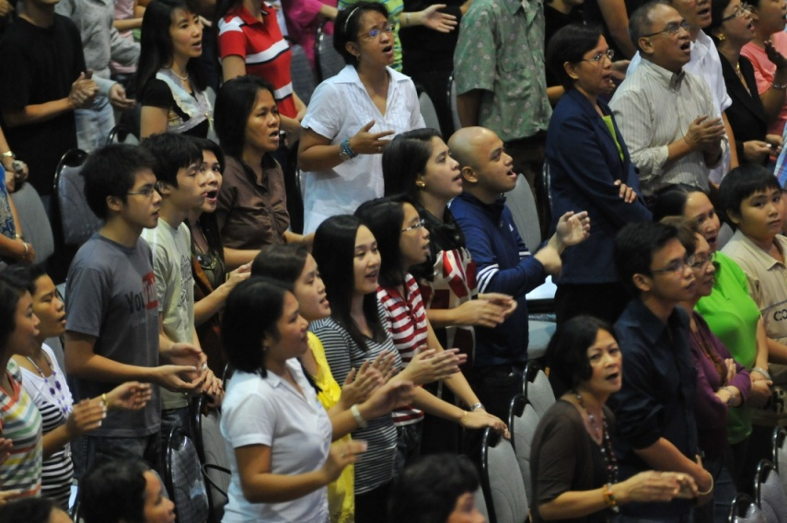
We’d love to get to know you. We want to help you learn more about God and his gift of life. We can also clarify things regarding this life-changing decision.
Visit us at www.fhmac.org.
Or, come attend a worship service on Sunday and meet people who have decided to follow Jesus Christ.
God bless you, and have a good day.
Notes:
Please tell us something about yourself (Personal info form appears.) and the decision you have made. (Decision choices appear.) We want to help you grow in God and know more about the abundant life. We can also clarify things regarding this life-changing decision. So, we’ll be in touch.
29

